Slide 1


Digital Secured Web Services
Delivered
Enable secure sockets layer (SSL) to encrypt a user’s communication with the Web server.
Enable SSL on the Web Services
Increased Customer Trust in using the Company Web Sites as the data being transfer is more secured
Improved Customer / Visitor overall experience with secured Web Sites
Problem Statement
All company Web Sites are unencrypted and run on HTTP
Company observes security concerns
Challenges in enabling SSL on some of company Web Sites as they run on old version of software
Solution
HTTPS Proxy server to translate HTTPS requests from client into HTTP request to Web Services and vice versa
Enablers
Container based solution which will enable to deploy the web services onto multiples instance quickly and ease of upgrade
Improved customer efficiency due to enhanced web sites
Higher Value Realization from Investments
Notes:
https://www.happiestminds.com/casestudies/Self-Knowledge-Assembly-Platform-Transforms-Customer-Service.pdf

Slide 2
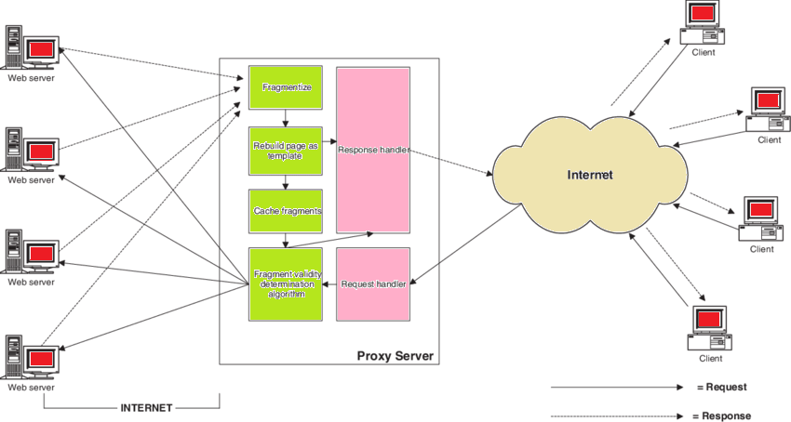
Context Architecture

Slide 3
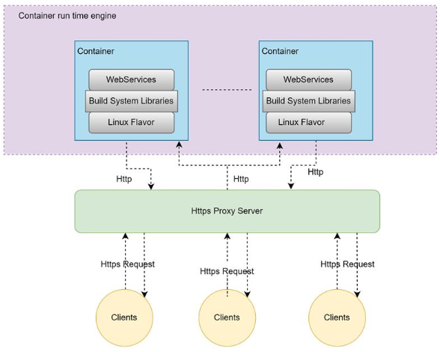
Container Architecture

